Slide 1
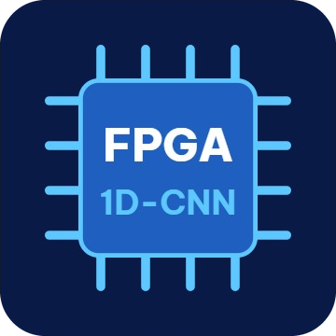
FPGA & MCU Design Contest, Extended Central Region 2026 · Final Round
Team VKU-NewBie
CHEST-WORN FALL DETECTION DEVICE
USING AN INT8 1D-CNN ACCELERATOR
ON A GOWIN FPGA
Team members
Nguyen Ba Thien (leader) · Dang Van Rin · Le Thanh Danh · Tran Phan Minh Tien · Bui Quoc Khanh
1

Slide 2
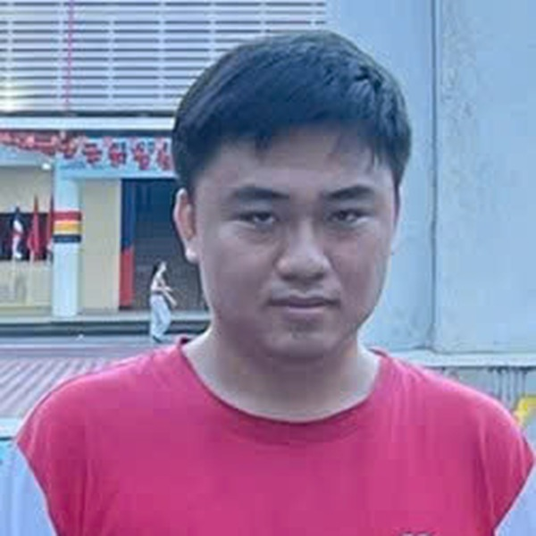
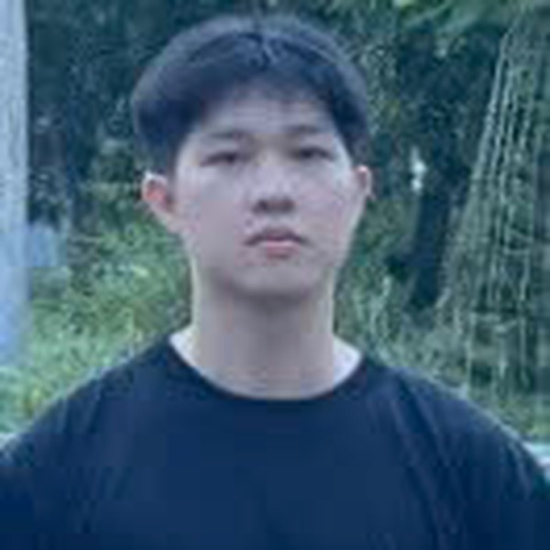

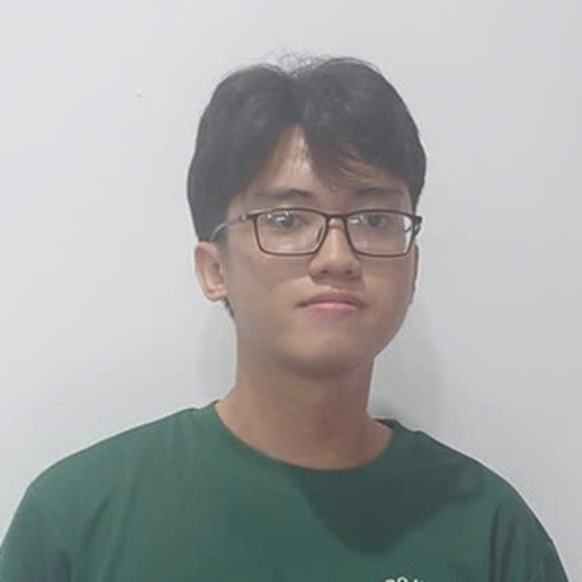
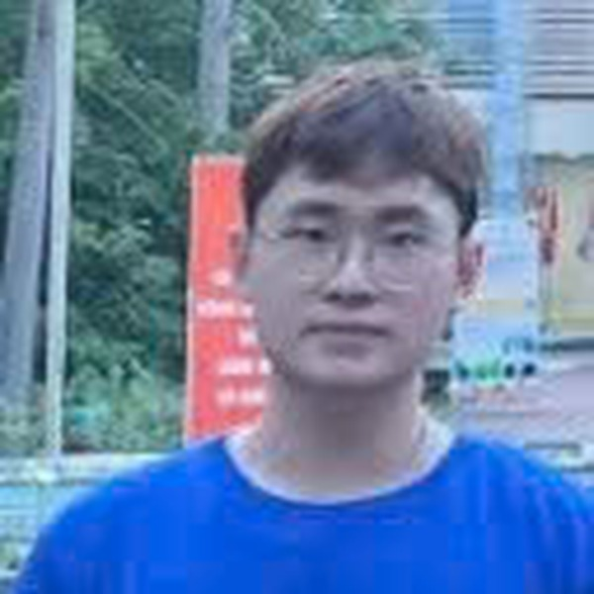
Team VKU-NewBie
Nguyen Ba Thien
Dang Van Rin
Le Thanh Danh
Tran Phan Minh Tien
Bui Quoc Khanh
Team leader

Slide 3
Detect real falls on the device, stay silent otherwise
Project goal
Project goal
On the device
No PC, no cloud: the CNN runs as hand-written RTL on a Gowin FPGA
Build a battery-powered, chest-worn device that detects a real fall on the device itself, using a 1D-CNN running as hand-written RTL on a Gowin FPGA. It alerts at once by buzzer and web page, and stays silent for hard sitting, bending and lying down.
Alert at once
Buzzer and web page as soon as a fall is confirmed
Silent for daily motion
Hard sitting, bending and lying down do not raise an alert

Slide 4
Table of contents
1
2
3
4
Project overview
System Architecture
Technical Solution
Results and Demo

Slide 5
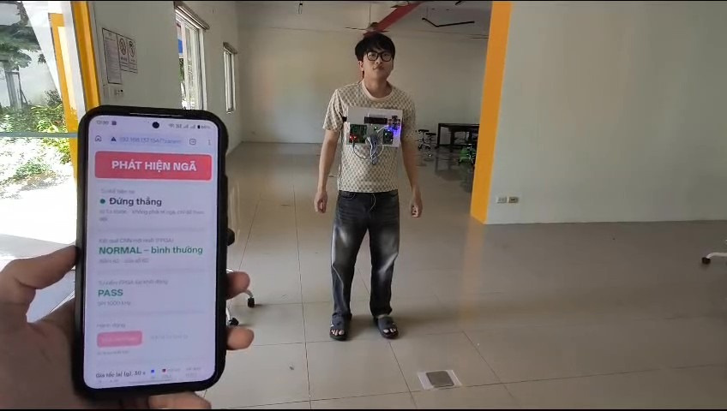
Why a chest-worn device?
1. Project Overview
A person who falls alone often cannot call for help.
The device must decide by itself: no PC, no cloud.
Strapped to the torso, it stays on the body during a fall.
Chest orientation shows body posture: standing, sitting, bending or lying.
Impact alone is not enough: a hard sit on a chair can hit harder than a fall on a mattress.
Device worn on a chest strap, field test

Slide 6





What the device does
1. Project Overview
On the device
Two-stage decision
Silent for daily motion
Detects falls on the device itself, no PC or cloud
CNN on the FPGA plus four physical signs confirm a fall
Built to stay silent for hard sits, bending and lying down
Alert at once
Battery powered
Buzzer and web page alert at once; a countdown leads to an alarm if the wearer stays still
Runs on battery, with a 3 s SOS button

Slide 7
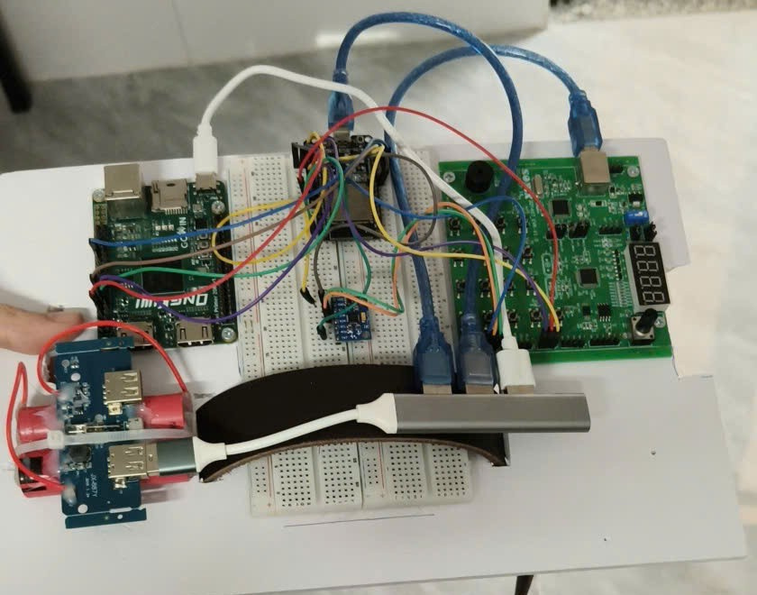
How it works: the prototype on a chest strap
1. Project Overview
On the plate
Left: Kiwi Primer 20K (GW2A-18), runs the CNN
Center: ESP32 hub and MPU6050 sensor
Right: SONiX SN32F407 EVK, reads the sensor, drives the buzzer
Lower left: battery packs
Prototype plate on a chest strap, running on battery

Slide 8
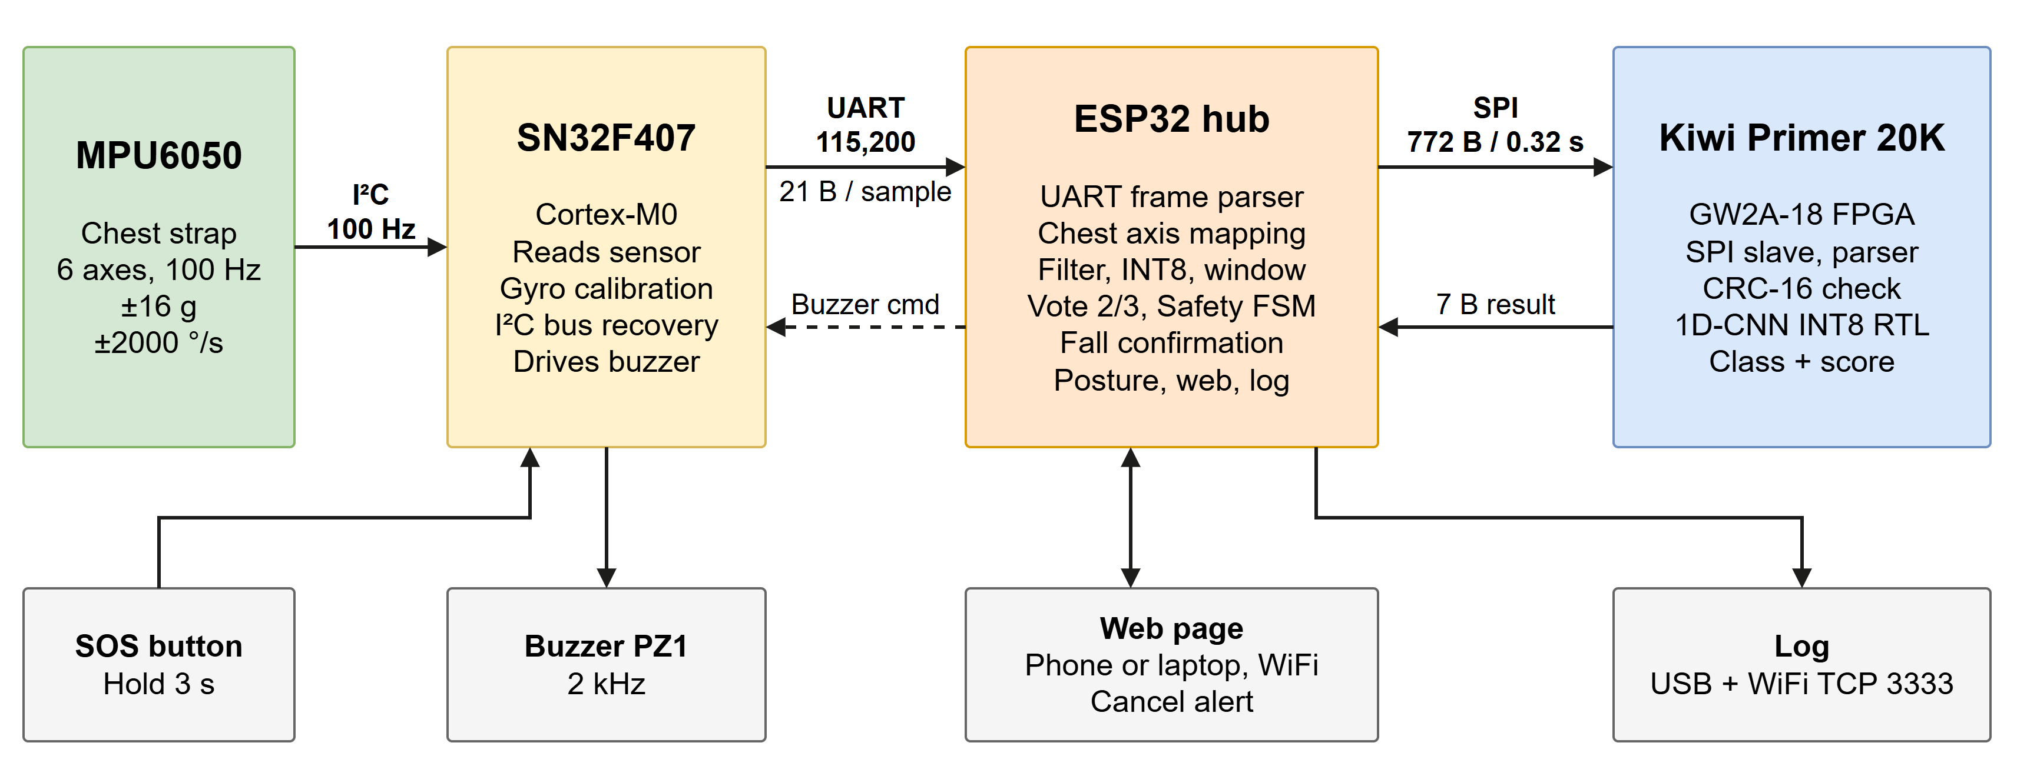
Block diagram: sensor, MCU, ESP32 hub and FPGA
2. System Architecture

Slide 9
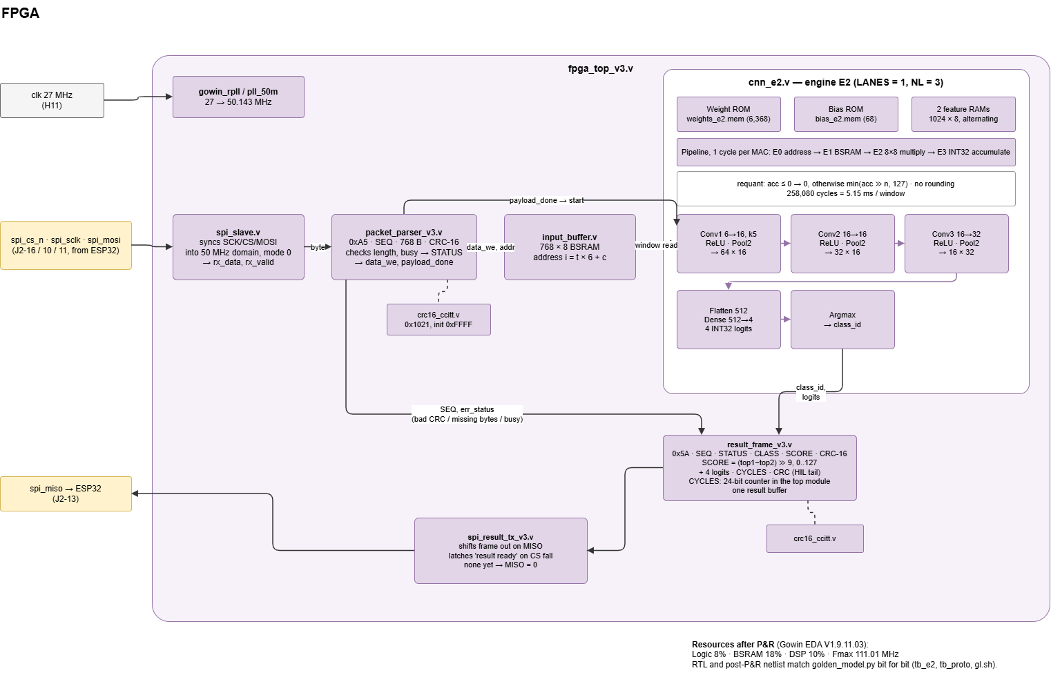
RTL architecture on the FPGA
2. System Architecture

Slide 10
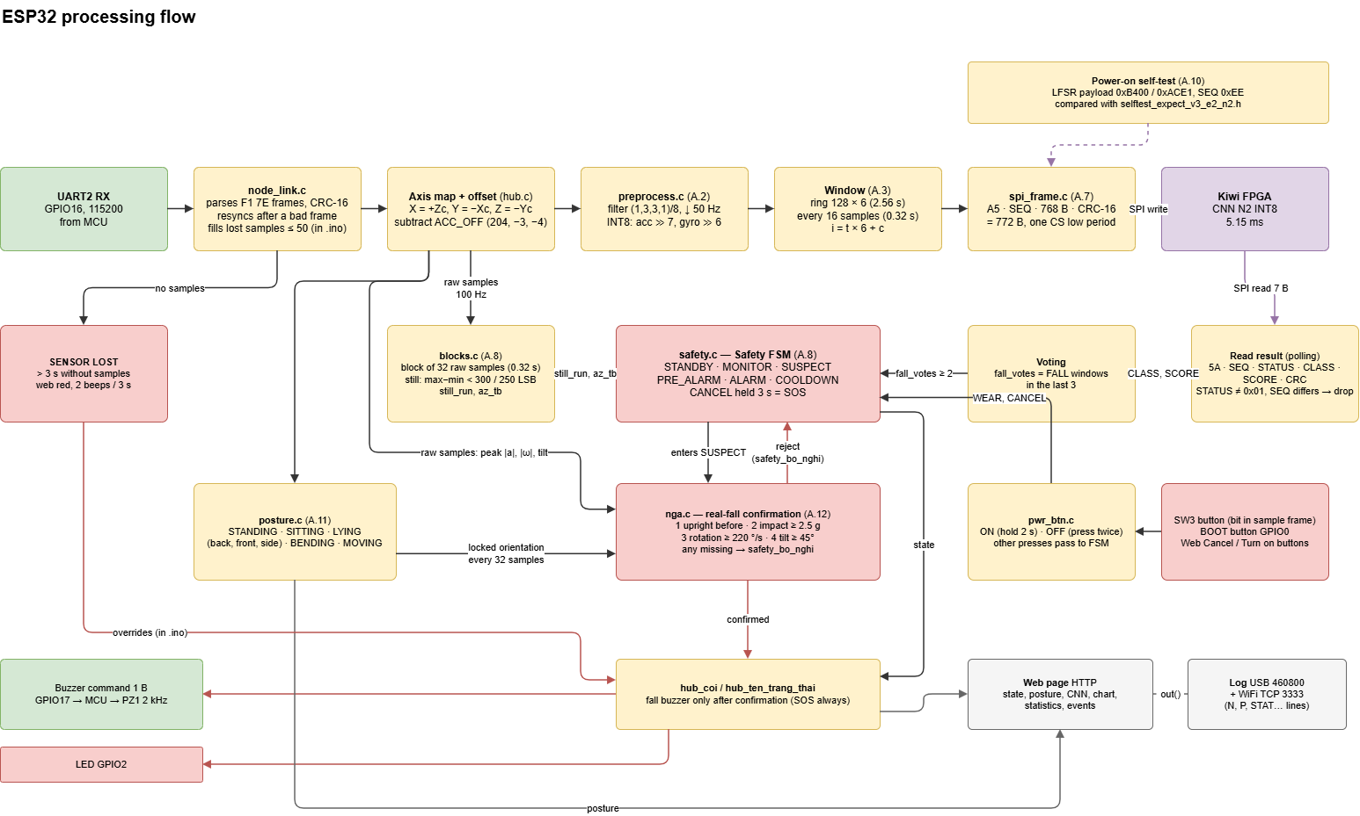
ESP32 architecture
2. System Architecture

Slide 11
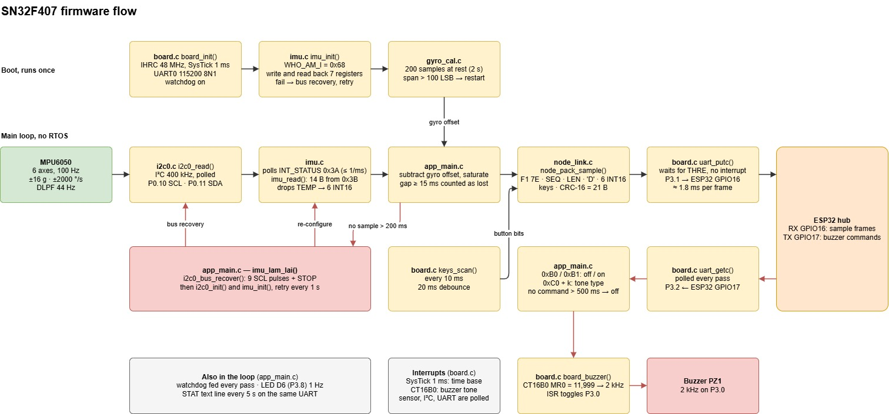
MCU architecture
2. System Architecture

Slide 12
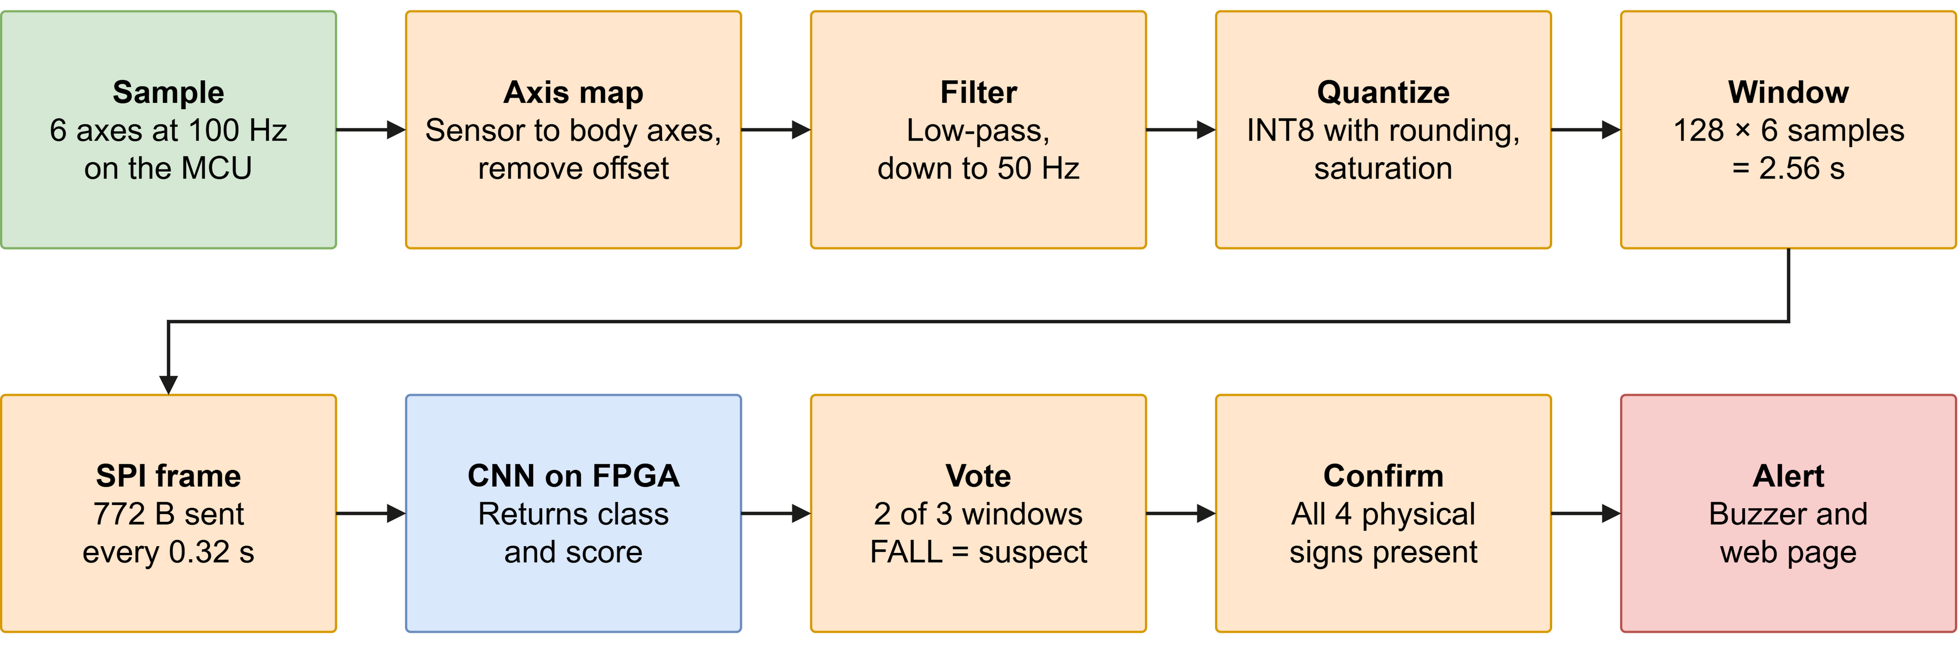
From motion to decision
2. System Architecture

Slide 13
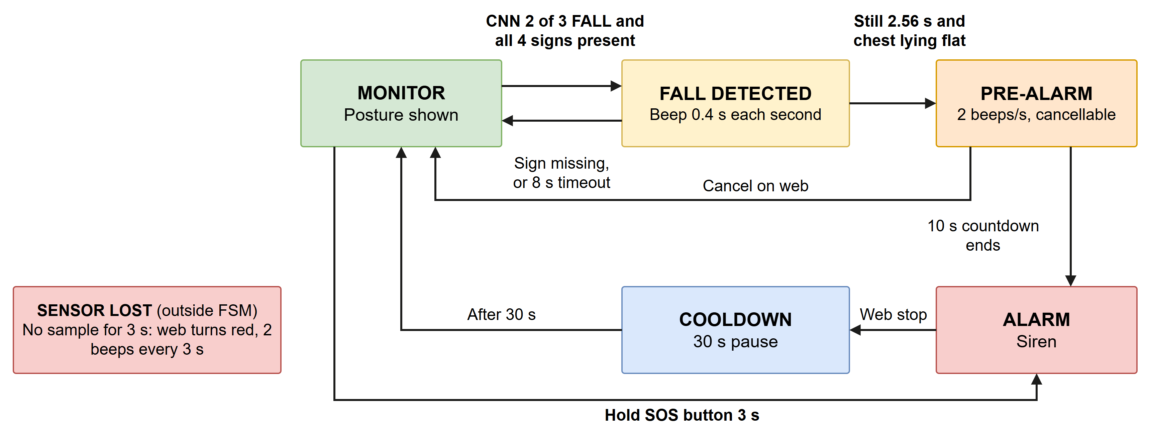
Safety state machine
2. System Architecture

Slide 14
Two data sources, two different jobs
3. Technical Solution
Public dataset: trains the CNN
Team logs:
Özdemir & Barshan, UCI #455, chest sensor
Worn on the chest
8 of 17 subjects converted
840 simulated falls across 20 fall types
16 daily activities
79,124 windows in total
Simulated falls by volunteers
9 held postures
Hard sit ×10, bend ×5, walk 30 s, lie down ×5, sit up ×5, roll ×10
14 tries of falling on a thick mattress with a spotter; 14 count as falls
One person, one session

Slide 15
N2 network architecture
3. Technical Solution
Layer | Output | Weights
Input, INT8 | 128 × 6 | 0
Conv1D 6→16, k = 5, ReLU, MaxPool 2 | 64 × 16 | 480
Conv1D 16→16, k = 5, ReLU, MaxPool 2 | 32 × 16 | 1,280
Conv1D 16→32, k = 5, ReLU, MaxPool 2 | 16 × 32 | 2,560
Flatten | 512 | 0
Dense 512→4 | 4 logits | 2,048
Argmax + score | Class, score | 0
Total, plus 68 bias values |  | 6,368
Integer only
227,328 MAC per window.
Weights and inputs are INT8; the accumulator is INT32.
After each layer: right shift, then clamp to 0…127.
The system uses NORMAL and FALL. The other two logits are reserved for later classes.

Slide 16
Why N2: same compute, far better accuracy
3. Technical Solution
Metric | N1: 2 Conv + GAP | N2: 3 Conv + Dense | Target
Weights | 3,168 | 6,368
MAC per window | 225,408 | 227,328
Macro-F1, INT8 | 0.842 | 0.977 | ≥ 0.90
Falls detected, event level | 87.0 % | 99.6 % | ≥ 95 %
Inference time | 13.96 ms on E1, simulation | 5.15 ms on E2, on the board | ≤ 6 ms
MAC count rises by only 0.9 %.
N1 misses both the fall detection target and the inference time target.
N2 keeps time order through Flatten + Dense instead of averaging it away.

Slide 17
Accuracy on subjects the model never saw
3. Technical Solution
Seed | Macro-F1 | Falls detected
20261014 (final) | 0.9823 | 1172 / 1179
7 | 0.9813 | 1174 / 1179
99 | 0.9847 | 1175 / 1179
Mean | 0.983 | 99.6 %
Confusion matrix, windows, sum of 3 seeds
 | Predicted NORMAL | Predicted FALL
True NORMAL | 317,983 99.79 % | 658 0.21 %
True FALL | 92 0.87 % | 10,519 99.13 %
8 subjects, one held out at a time
Weakest subject: Macro-F1 0.924–0.964, with limping, ankle twists and stumbles
These are CNN figures on the chest sensor, before any confirmation step

Slide 18
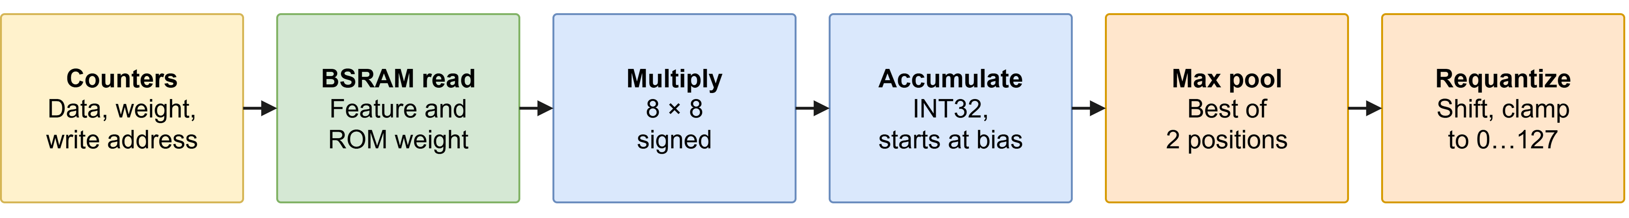
Engine E2: one MAC per clock cycle
3. Technical Solution
Data is stored position first, so a convolution window is one continuous address range.
All three addresses are plain +1 counters: no address multiplier is needed.
Requantize: acc ≤ 0 gives 0, otherwise min(acc >> n, 127).
5.15 ms
1.50 ms
258,080 cycles
75,284 cycles
1 lane, final bitstream, measured on the board
4 lanes, simulation only, not in the bitstream

Slide 19
Resource use on the GW2A-18
3. Technical Solution
Logic
Maximum frequency
8 % · 1,473 of 20,736 · limit 20 %
111.01 MHz
Registers
7 % · 1,084 of 16,173
BSRAM
Committed target: at least 55 MHz
Clock in use: 50.143 MHz
18 % · 8 of 46 · limit 25 %
DSP
10 % · 2.25 of 24 · limit 25 %

Slide 20
Inference time: FPGA against the MCU alone
3. Technical Solution
The FPGA is about 18 times faster than the MCU, both measured on the board; the target was at least 5 times.
Share of the 0.32 s step: about 1.6 % on the FPGA, against about 29 % on the MCU.
An MCU alone could run a network this small. The FPGA adds headroom and a fixed cycle count.

Slide 21
Impact alone cannot separate a hard sit from a fall
3. Technical Solution
Motion, worn on the chest | Peak |a| | Max tilt after impact | Peak rotation
Hard sit on a chair × 10 | 4.30–6.17 g | 18–31° | 85–149 °/s
Fall on mattress, then lie still × 10 | 2.58–5.29 g | 58–80° | 281–467 °/s
Light fall, then sit up × 4 | 3.33–3.77 g | 68–78° | 258–385 °/s
Lie down on a bed × 5 | 1.03–2.74 g | 85–96° | 12–192 °/s
Bend to pick up × 5 | 1.51–1.68 g | 66–72° | 175–210 °/s
Threshold chosen from this table | ≥ 2.5 g | ≥ 45° | ≥ 220 °/s
A hard sit hits harder than a fall on a mattress, yet tilt and rotation separate them.
In the motion log with no falls, replayed on a PC, the CNN suspected 22 times: 19 during hard sits, 3 during rolling.
So the CNN raises a suspicion; four physical signs make the decision.

Slide 22
Stage 2: four physical signs, all required
3. Technical Solution
1. Posture before
2. Impact
3. Fast rotation
4. Chest tilted
Upright
≥ 2.5 g
≥ 220 °/s
≥ 45°
Chest was upright 3.2–10.2 s before the suspicion
Peak acceleration within the 3.84 s before the suspicion
Peak rotation within ±1.6 s around the impact
From vertical, within 3.84 s after the impact
All four present: the web page shows FALL DETECTED and the buzzer sounds.
Any sign missing: the suspicion is dropped silently, and the wearer sees nothing.
Runs on the ESP32 in firmware/src/nga.c, on raw 100 Hz samples in body axes.

Slide 23
From 7/9 to 9/9 postures, with two fixes
3. Technical Solution
Fix 1: accelerometer offset
9/9
One axis read about 0.1 g off, so the device thought it was always moving. We remove (+204, −3, −4) LSB, fitted from 9 still postures.
postures correct in the team log
Standing, sitting, standing up, bending, upright again, lying on the back, on the right side, on the left side and face down.
Fix 2: deep bend rule
Bending (79°) and lying face down (78°) look the same. Chest height separates them: −0.20 m when bending, −0.89 m when lying down.
Posture is display only. It does not change the fall decision.
Body axes: X forward, Y left, Z up. Sensor to body: X = +Z, Y = −X, Z = −Y.

Slide 24
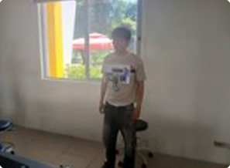
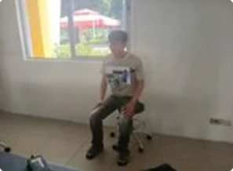
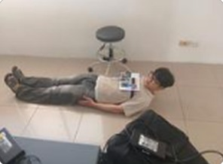
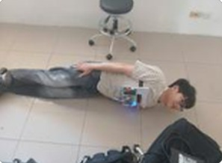
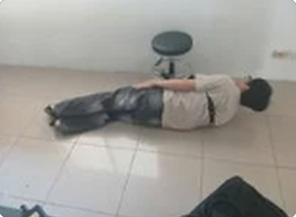
Held postures, worn on the chest strap
3. Technical Solution
Standing
Sitting
Lying on back
Lying on left side
Lying on right side
5 of 9
0
Display only
held postures pictured here. All 9 are recognized correctly in the team log.
alerts when lying down on a bed × 5: peak rotation stays at 12–192 °/s, under the 220 °/s threshold
Posture is shown on the web page. It does not change the fall decision.

Slide 25
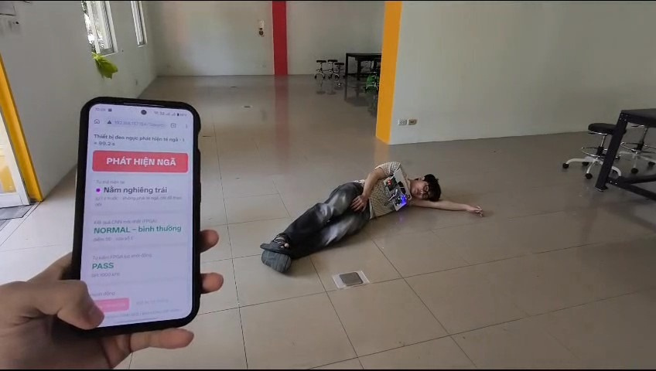
Alert and web page, served by the ESP32
3. Technical Solution
Served by the ESP32:
State banner
Current posture and history
Latest CNN class and score
FPGA self-test result
Acceleration chart, 30 s
Fall count, samples, lost frames
Event log, cancel button
No extra app or cloud
Field test: the phone shows fall “detected” and the posture “lying on the left side”
Any phone or laptop on the same WiFi opens the device’s IP address.

Slide 26
When something fails, the device does not stay silent
3. Technical Solution
Fault | Response | Evidence
UART noise | Accept only full-length frames; resync inside a bad frame | 6 noise events in 200 frames: exactly 6 samples lost (test)
Missing samples | Gaps up to 50 samples filled with the latest sample | Board run: 0 lost of 200,607
I2C stops answering | After 200 ms, recover the bus and reconfigure every second | Firmware behavior, SPEC
Sensor hangs | After 3 s: SENSOR LOST, red web page, 2 beeps every 3 s | Fix today: remove battery for about 5 s
FPGA fault | Boot self-test: fixed frame, compare with a stored answer | Board: PASS, 7 bytes match simulation

Slide 27
Results, each with its source
4. Results and Demo
Test | Result | Source
Hard sit on a chair × 10: false alerts | 0/10 | Replay on PC, team log
Whole motion log, no falls: false alerts | 0 | Replay on PC, team log
Fall on a thick mattress: reported | 14/14 | Replay on ESP32 + FPGA
9 held postures: correct | 9/9 | Replay on PC, team log
Samples lost; FPGA frames OK | 0; 6,261/6,261 | Board

Slide 28
What we will show
4. Results and Demo
1
Power on from battery: self-test PASS
2
Stand, sit, bend, lie down: posture updates, no alert
3
Hard sit, lie on a bed, roll over: stays silent
4
Fall on a mattress, then get up: FALL DETECTED, buzzer
5
Fall and lie still: 10 s countdown, then cancel
6
Fall and lie still again: ALARM
Falls in the demo.
7
Hold the button 3s: SOS

Slide 29
THANK YOU
Q&A
Team VKU-NewBie
29

